Slide 1
HawkStudy - Team E
By: Alan P, Anwar A, Labib K, Mansoor S, Neil B

Slide 2
Problem Statement
College Students need study spaces, to have a resourceful environment to study, learn, grow and collaborate with peers.
Lack of an effective online space reservation system is halting student’s academic success.
Waiting in line to find a study space increases the likelihood of contracting Covid-19 and risks the reception staff with catching the virus.
Students with busy schedules and commitments can’t afford to lose time waiting for a room, and therefore prefer a reserved space beforehand to be time efficient.

Slide 3
Customers
Students who don’t like studying in a cramped area.
Students who would like to have access to equipment like whiteboards and monitors
Students who don’t have the time to go around campus to find areas to study at.
Students who want their own privacy and who want to study individually.
Students who want to collaborate with other students to work on projects, homework, etc.

Slide 4
Personas
Kunj the researcher, 20
Kunj is a student researcher, and has a packed schedule. His roommate is social and brings his friends over to the room, and therefore Kunj uses HawkStudy to reserve campus spaces to study, research and go over notes in his free time. HawkStudy saves him time and makes his study times be more organized and efficient.
Dillon the film director, 25
Dillon is a grad student who has a small scale youtube channel. He has a team of 6 people and doesn’t have space in his dorm room and extra equipment as monitors, whiteboards, and others. Dillon uses HawkStudy to reserve big study spaces so his team can work together on the youtube channel and can plan space reservations ahead of time rather than waiting in line with an uncertainty.

Slide 5
Scenario
Kira is attending his lecture and gets an assignment which is due this weekend. He decides to chec ‘HawkStudy’ to check the real time availability of the study halls on campus. ‘HawkStudy’ would tell the availability of study halls near him and open the fill-up form. It sends a barcode which Kira can scan at the reception to get his access to the room. Kira can also check how many people can be in the room so he knows how many friends to invite to complete the assignment with him.

Slide 6
Work Distribution
Neil (Sophomore in Computer Science): Personas, Scenarios, Demographics.
Alan (Sophomore in Computer and Cybersecurity Engineering) and Anwar (Sophomore in Artificial Intelligence): Front-end GUI development.
Labib (Sophomore in Computer Science) and Mansoor (Sophomore in Computer Science): Database management and connectivity.

Slide 7
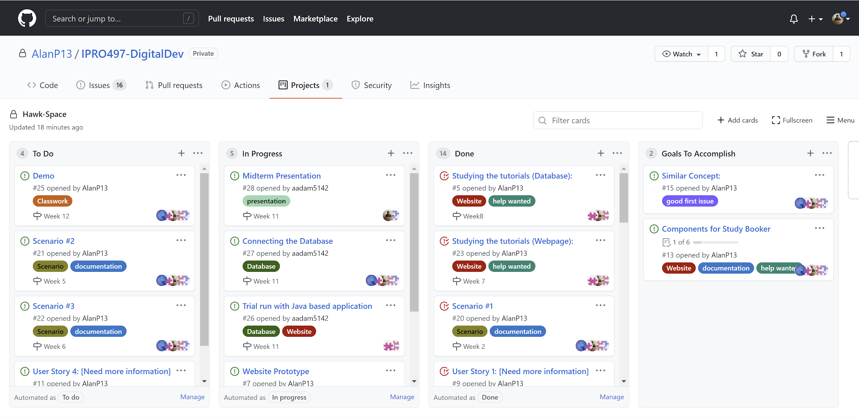
Kanban board

Slide 8
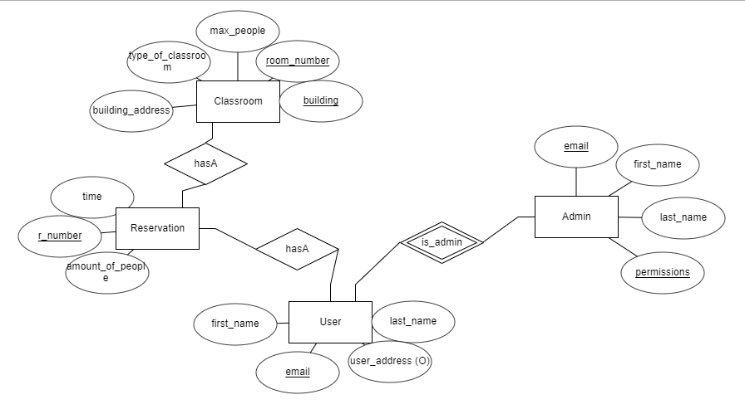
ER Diagram

Slide 9
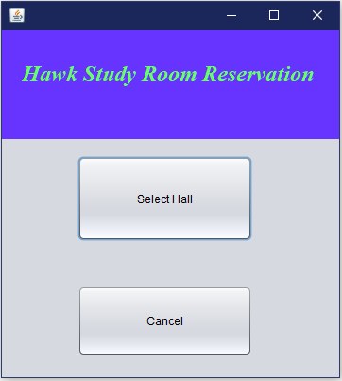
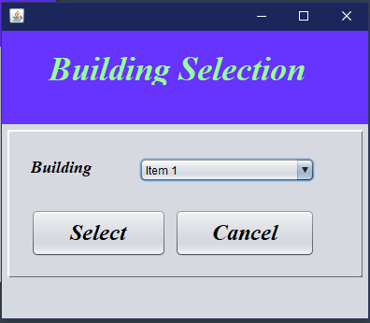
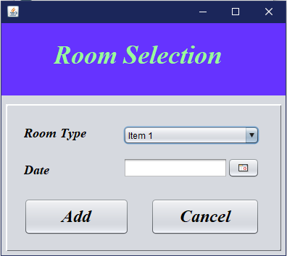
Java Application Layout

Slide 10
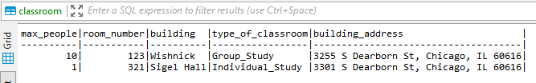
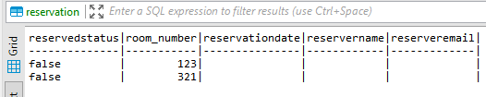
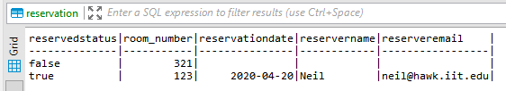
SQL Updates
If someone reserves a room from the Application GUI then the reservation will get updated in the database. For ex: Neil reserves room 123, a group study room, on 4/20/2021

Slide 11
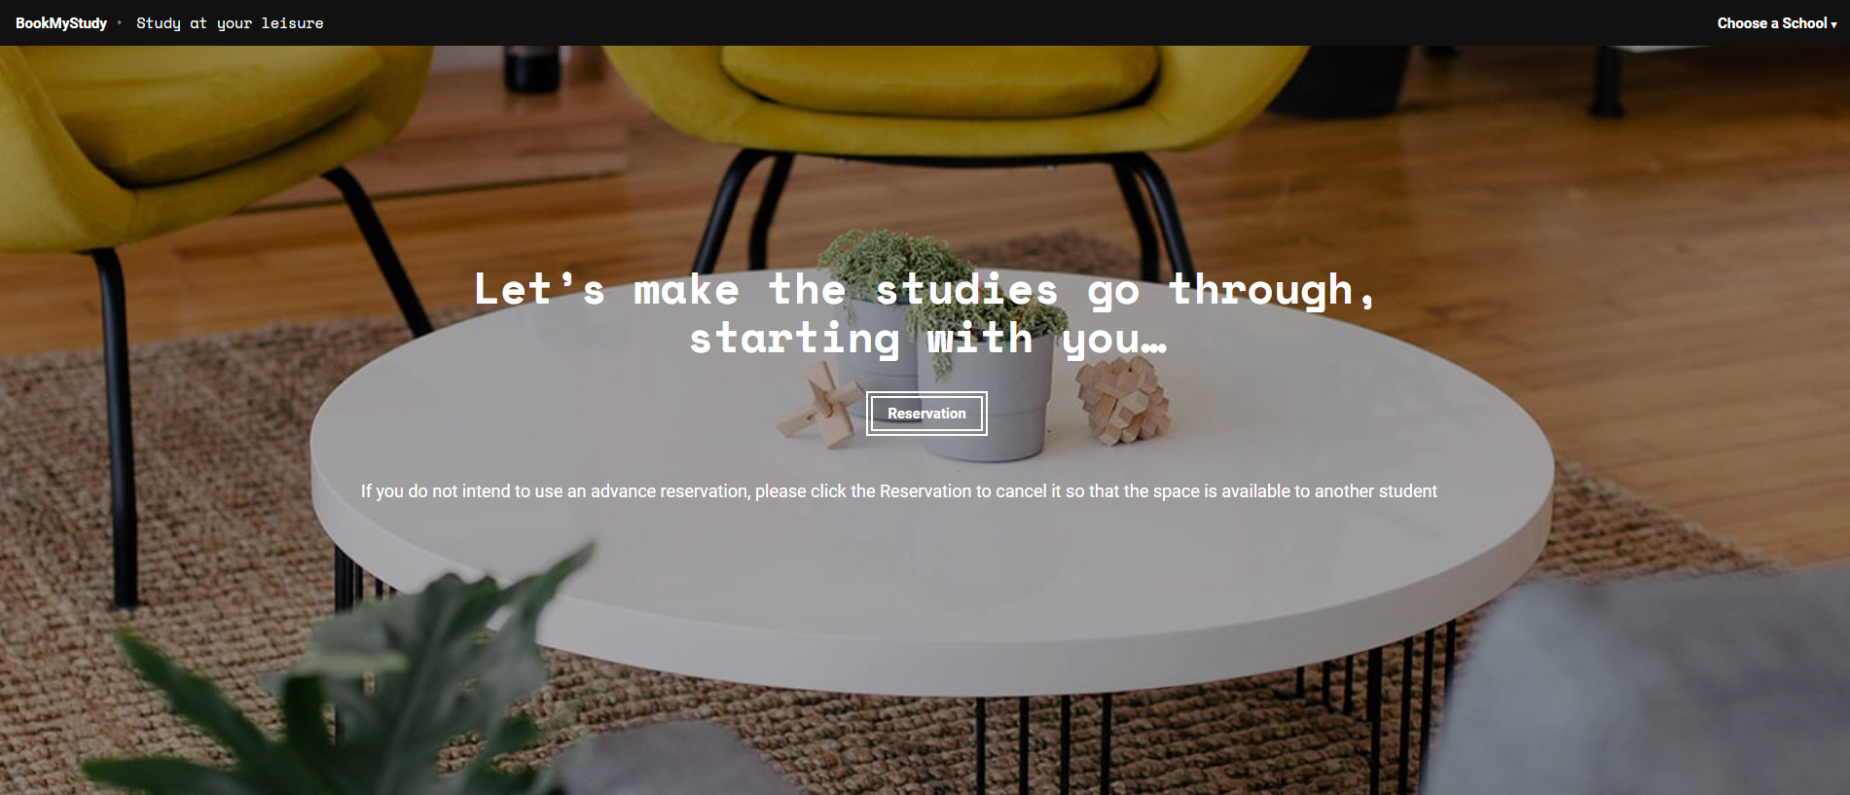
Webpage Layout

Slide 12
Scenario #2
Armin and Sasha want to study for their exam, but they can’t focus because their roommate, Eren, is busy partying. They go to ‘HawkStudy’ and search for available spaces on campus to study. Sasha also wants to have some food during the study session, so she asks Armin to find a room that allows food. They find the nearest building that is free near their dorm and book it for 1 hour. They receive reminder emails about the reservation to study in the location.

Slide 13
Scenario #3
Reiner is a commuter student on campus and always has a hard time finding a place to study during his breaks. He looks at the ‘HawkStudy’ website advertised on campus and is able to find a wide variety of study rooms that are open for him to reserve and study without having to worry about the place already being used. Reiner is also trying to be very COVID-19 safe so he looks for rooms shown on the website that are labeled as not busy through the realtime data shown.

